Slide 1
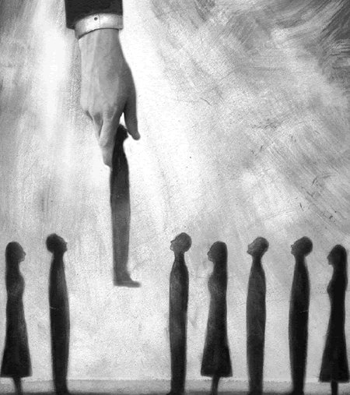
The Doctrine of Election
Soteriology: God's Rescue Program
Dr. Rick Griffith • Jordan Evangelical Theological Seminary • BibleStudyDownloads.org

Slide 2

Defining Election
55
God's choice of an individual or group for a specific purpose or destiny

Slide 3
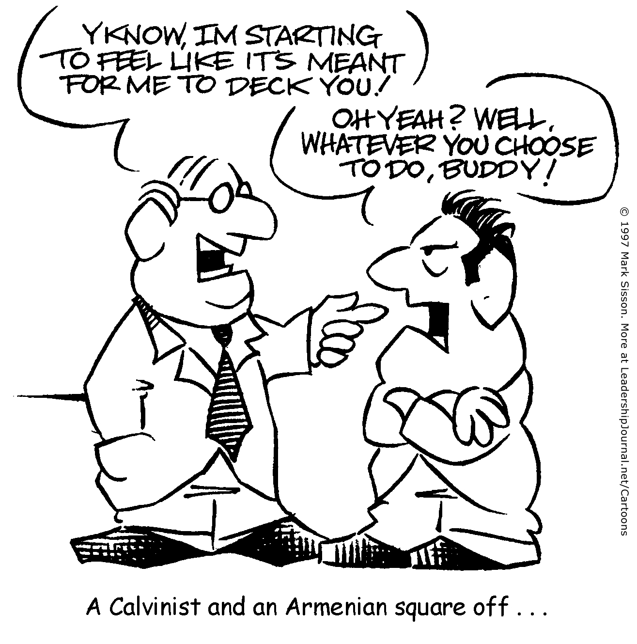
A Calvinist and an Armenian square off…
YA KNOW, I'M STARTING TO FEEL LIKE IT'S MEANT FOR ME TO DECK YOU!
OH YEAH? WELL, WHATEVER YOU CHOOSE TO DO, BUDDY!
?

Slide 4
A Calvinist and an Arminian square off…
YA KNOW, I'M STARTING TO FEEL LIKE IT'S MEANT FOR ME TO DECK YOU!
OH YEAH? WELL, WHATEVER YOU CHOOSE TO DO, BUDDY!
!

Slide 5

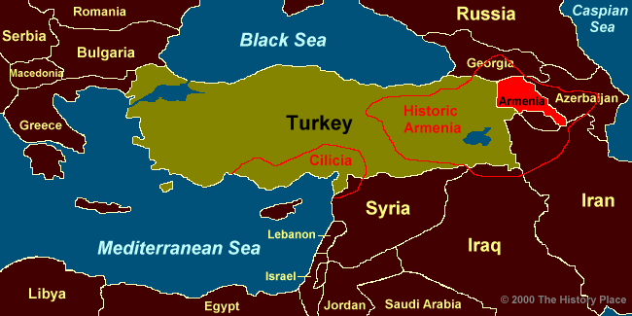
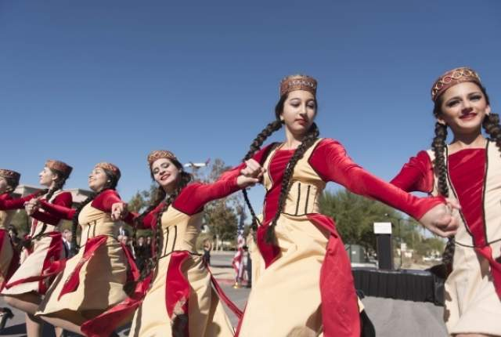
Armenian or Arminian?

Slide 6

Predestination

Slide 7

Election has no conditions
Total Depravity
Unconditional Election
Limited Atonement
Irresistible Grace
Perseverance of the Saints

Slide 8

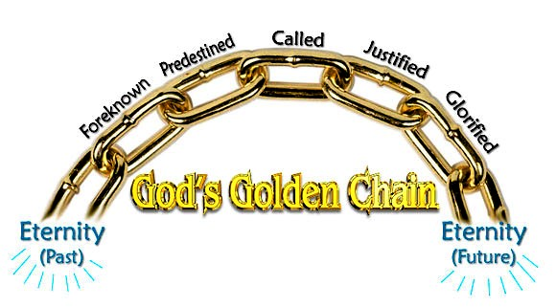
Five Unbreakable Links in God's Plan of Salvation
51
Called
Predestined
Justified
Foreknown
Glorified
God's Golden Chain
Eternity
(Past)
Eternity
(Future)
Notes:
Five Golden Links in God's Chain of Salvation
Posted by Editorial on July 14, 2015 at 6:46 pm
http://www.dallastelegraph.com/58850
Accessed 14 May 2016
By Elder Herb Hatfield, Pastor, Aberdeen Primitive Baptist Church, Aberdeen, Mississippi, USA
"For whom he did foreknow, he also did predestinate to be conformed to the image of his Son, that he might be the firstborn among many brethren. Moreover whom he did predestinate, them he also called: and whom he called, them he also justified: and whom he justified, them he also glorified." ROMANS 8:29-30
Introduction: Salvation is a grand and glorious subject. The salvation of a Hell-deserving soul from the torments of an eternal Hell is both amazing and glorious. What a wonderful thing that a person can, by the grace of God, be saved from eternal Hell. However, salvation is more than just deliverance from Hell, it involves much more. It includes our Redemption, our Regeneration, our Adoption as sons of God, our Sanctification and our eternal dwelling with God in glorified bodies. Dwelling eternally in Heaven with Jesus Christ our Saviour in our glorified bodies is the final result of the whole process of our salvation.
There are only two places that a soul can go after death, Hell or Heaven. Salvation is the whole process whereby God justifies, saves a Hell-deserving sinner by His free and sovereign grace, and gives them eternal life. They are regenerated, causing them to desire to live godly and glorified so they can then enjoy eternity with God the Father, God the Son, God the Holy Spirit, with the Holy angels and all the redeemed saints from all ages, with glorified bodies. That, my friends, is what salvation is all about; it is the delivering of a mortal soul from Hell's damnation and giving it eternal glory in Heaven. It is amazing! It is marvelous! It is wonderful and it is all true! God's plan for salvation ends in eternal glorification for all the saints of God.
These scripture verses set forth this glorious program of salvation. These verses say that those whom God did foreknow, He also did predestinate to be conformed to the image of His Son, and those whom He did predestinate, them He also called, and whom He called, them He also justified, and whom He justified, them He also glorified. There are five very important words in these verses. They are: Foreknow, Predestinate, Called, Justified and Glorified. These five words cover the whole program of God in the salvation of His people. This salvation is what I want to talk to you about, using these five words. I call them Five Golden Links in God's Chain of Salvation.
The Bible says that God has declared the end from the beginning (Isaiah 46:10).
Therefore, I want to take these five words in Romans, chapter eight, verses 29-30 in the reverse order that we have here. The last word is Glorification. That's where salvation ends, in our glorification, so I want to start with glorification and then work backwards. I want you to think with me about each of these five golden links in this chain of salvation.
The FIRST link in the chain that I want to discuss with you is the last one, GLORIFICATION. What a wonderful subject. Do you ever think about it? The Bible talks about it right here in these verses. It is what happens to the saints of God when they are given bodies in which they shall live forever. In I Corinthians chapter fifteen, the Apostle Paul talks about the resurrection and the glorification of our bodies. He even says that every saint may not necessarily die, but that we all shall be glorified. He says: "Behold, I shew you a mystery; We shall not all sleep, (that means die, that's what death is for the saints), but we shall ALL BE CHANGED, in a moment, in the twinkling of an eye, at the last trump: for the trumpet shall sound, and the dead shall be raised incorruptible, and we shall be changed. For this corruptible must put on incorruption, and this mortal must put on immortality" (I Cor.15:51-53). That's the same thing that the Apostle is talking about in Philippians chapter three where in verses 20 and 21 he says; "For our conversation (citizenship) is in heaven: from whence also we look for the Saviour, the Lord Jesus Christ: who shall CHANGE OUR VILE BODIES, that it may be fashioned like unto His glorious body".
This is what all the saints of God are looking forward to, when we shall have glorified bodies. We will have bodies that have been changed by the power of God, so that we put off mortality and put on immortality. These are bodies that have been "fashioned like unto His glorious body"! That is what the Apostle John is speaking about in I John chapter three, verses one and two when he says, "Behold what manner of love the Father hath bestowed upon us that we should be called the sons of God:…Beloved, now are we the sons of God, and it doth not yet appear what we shall be: but we know that, when He shall appear, we SHALL BE LIKE HIM, because we shall see him as He is."
Can you imagine it? Glorified bodies! Bodies that have been made like unto Jesus Christ's body. Not that we shall be gods, but we shall have bodies that will never die; there will be no pain or sickness, but most of all, no sin in them. We shall possess sinless bodies so we can sing and praise the Lord our Saviour for all eternity with pure hearts and glorified bodies. That's what Romans chapter eight says that salvation is all about. It says in verse 29 that we have been PREDESTINATED "to be conformed (that means made like) to the image of His Son". All who have trusted Jesus Christ as their Lord and Saviour in this life shall receive glorified bodies in eternity. That is our hope, it is our comfort in the time of sorrow and trouble, and it is what God has promised us, it is what He has predestined for us. Paul says in Romans 8:18: "For I reckon that the sufferings of this present time are not worthy to be compared with the glory which shall be revealed in us". HALLELUJAH!!! This is what makes the struggle and suffering for Christ all worthwhile. We who are the saints of God shall all, some day, be given glorified bodies to enjoy for all eternity in Glory. That is what David is referring to when he said, "As for me, I will behold thy face in righteousness: I shall be satisfied, when I awake, with thy likeness" (Ps 17:15). That, my friends, has been the hope of all saints in all ages. Job, in the oldest book in the Bible said, "For I know that my redeemer liveth, and that he shall stand at the latter day upon the earth: And though after my skin worms destroy this body, yet in my flesh shall I see God: Whom I shall see for myself, and mine eyes shall behold, and not another; though my reins be consumed within me." (Job 19:25-27)
I want you to see whom it is that is to be glorified. Paul says here in these verses that it is those who have been justified. In verse 29 of this eighth chapter of Romans, he says that those "whom He (God) justified, them He also glorified". I want you to see here that ONLY those who have been JUSTIFIED by God are going to be GLORIFIED. That's what the Bible says right here. It does not say those who live right, or those who joined the church, or those who have been baptized, or those who have done anything. No, it is ONLY those whom God has JUSTIFIED. This then is the second link in the golden chain of salvation, JUSTIFICATION.
JUSTIFICATION is a very, very important subject. It's a legal term. It speaks about our standing before the bar of God's Holy Law. The Word of the Lord says in Romans chapter three, that "all have sinned and come short of the glory of God", and that "there is none righteous, no not one". Therefore, before the bar of God's Holy Law, all mankind stands guilty of sin. We are all sinners because we all sinned in Adam and we are therefore worthy of eternal death in Hell. (Rom.5:12). But God did a wonderful and marvelous thing. He sent His only begotten Son into the world and laid upon Him all the sins of all those whom He would ever justify. Therefore, since the death and resurrection of Jesus Christ, God's Law has forever been satisfied concerning the sins of those whom He would justify and the guilty sinner has been declared, by God, to be just.
First, I want to show you the KIND OF PEOPLE that God justifies. In Romans 4:5 we read, "To him that worketh not, but believeth on Him (God) that justifieth the ungodly". There it is in black and white. Friend, read it and rejoice! The only kind of people that God justifies is "the ungodly"! It is not good people, nor religious people, nor those that feel themselves to be good people, but ONLY UNGODLY SINNERS! Paul says in First Timothy 1:15 that Christ died to save even the chief of sinners. In Romans 5:6, Paul tells us "when we were yet without strength …Christ died for the ungodly."
Now, I want to show you HOW it is that we are Justified. It is not by works that we do or by keeping the Law. In Acts 13:39, Paul says: "By Him (Jesus Christ) all that believe are justified from all things, from which ye could not be justified by the law of Moses". You see, the Law of Moses is good, but the Law cannot justify, it only condemns. It shows us our sin. It is like a mirror that we hold up and see our dirty faces. The mirror cannot cleanse our faces; we must use soap and water. Likewise, the Law of God shows us our sins, but it cannot justify us. The Bible teaches that it is God that justifies. In Romans 3:24 the Word of God says: "Being justified by His grace through the redemption that is in Christ Jesus".
You see, it is God that justifies us by His grace. Grace means without any merit. Therefore, God, by the good pleasure of His sovereign grace, justifies the guilty sinner. He does it "through the redemption that is in Christ Jesus." What that means is that Jesus Christ has paid the sin debt for all His people (Matt.1:21). The word "redemption" means, "to deliver by paying a price". That's what Jesus Christ did. He paid the price of death for the transgression of the guilty sinner. We read in the Book of I Peter 1:18-19: "Forasmuch as ye know that ye were not redeemed with corruptible things, as silver and gold, from your vain conversation (sinful conduct ) received by tradition from your fathers; but with the precious blood of Christ, as of a lamb without blemish and without spot." There is only one thing that could pay the price of our redemption; it was "the precious blood of Christ." .
In Romans 8:33, we see WHO it is that God justifies. "Who shall lay any thing to the charge of God's elect? It is God that justifies." There it is in black and white again. The people that God justifies are called "God's elect". They are the same people that we read about in Romans 8:28: "who are the called according to His purpose." God has justified His elect people by His free grace.
This brings us to the third word in the Golden Link of the Chain of our Salvation, it is the word CALLED. It is right there in our text in Romans chapter 8 and verse 30: "Moreover whom He did predestinate, them He also CALLED and whom He called, them He justified." Therefore, the people that God justifies are those who are "the called".
Paul began this Book of Romans by saying in chapter one and verse one: "Paul, a servant of Jesus Christ, called to be an apostle, separated unto the gospel of God." Then in verses six and seven, he addresses the book to "the called of Jesus Christ, to all that be in Rome, beloved of God, called to be saints". The word "called" is the Greek word "kaleo". This word is used 145 times in the New Testament. It means to name, or to bid, or command to come. It is used in Matthew 2:7 where we read "Then Herod, when he had privily called the wise men, inquired of them diligently what time the star appeared." You see its true meaning here. King Herod called the wise men to come to tell him about the star they had seen. These wise men had no choice about this matter, it was an invitation from one with supreme authority and it was to be obeyed. The same word is used in Matthew 4:21-22 where we read that Jesus "saw other two brethren, James the son of Zebedee, and John his brother, in a ship with Zebedee their father, mending their nets; and he called them. And they immediately left the ship and their father, and followed him".
Jesus Christ said in Matthew 9:13, "I am not come to call the righteous, but sinners to repentance." Peter says in Acts 2:39: "For the promise is unto you, and to your children, and to all that are afar off, even as many as the Lord shall call". Again, Paul says in I Thess. 2:12: "That ye would walk worthy of God, who hath called you unto His kingdom and glory." In First Peter 2:9, we read, "But ye are a chosen generation, a royal priesthood, an holy nation, a peculiar people; that ye should shew forth the praises of him who hath called you out of darkness into his marvelous light". God, by His Holy Spirit, has called (commanded to come) us from the spiritual darkness into which we were born by nature, into the marvelous light of the Son of God. It is what Christ did at the tomb of Lazarus in John chapter 11, when He said, "Lazarus, come forth" and next we read, "he that was dead came forth". So the call of God by His Holy Spirit to His elect, is both effectual and irresistible. Jesus Christ said in John 6:37, "All that the Father giveth me shall come to me." They are called by an IMMEDIATE, EFFECTUAL and IRRESISTIBLE drawing of the Holy Spirit of God, so that they willingly, by faith, come unto Jesus Christ, trusting Him as their Lord and Saviour.
If today you believe that, by the grace of God, you have been given a hope of your salvation in Jesus Christ, or if you shall ever be saved and glorified, it will be because God has called you. We would never have called on the Lord if God had not first called us. The Word of God says, "there is none that understandeth, there is none that seeketh after God" (Rom.3:11). Jesus Christ said in John 6:44: "No man can come to me, except the Father which hath sent me draw him…" We have all gone astray from God, so God must call us by His Holy Spirit and cause us to come unto Him. Psalms 65:4 says, "Blessed is the man whom thou choosest, and causest to approach unto thee". You see Friend; we come to God because He calls us and draws us to Himself. Therefore, in Jeremiah 31:3, God says, "with loving kindness have I drawn thee". Like Lazarus of old, we were dead in our trespasses and sins and God must first come to us and call us from darkness unto light. Whenever it is that the Holy Spirit comes to our dead hearts and calls us to Jesus Christ, we will be made alive and given eternal life.
We manifest God's spiritual life in us by believing the Gospel, by repenting of our sins, and by following Jesus Christ. All those that God has justified, He shall call from deadness unto life by His Holy Spirit, every one of them He will also glorify. It is very important that we see this clearly. The Holy Spirit of God shall call everyone whom God has justified by the death of His Son on the cross. This involves regenerating us so that we have faith in Jesus Christ as our Saviour. This is the work of the Holy Spirit of God as the third party to the eternal covenant of our salvation.
All of those whom the Holy Spirit has regenerated shall follow Jesus Christ. Christ said in John 10:27-28, "My sheep hear my voice (that is by the work of the Holy Spirit) and I know them (set my love upon them before the foundation of the world) and they follow me and I give unto them eternal life; and they shall never perish, neither shall any pluck them out of my hand". This means that all whom the Holy Spirit genuinely regenerates will be kept by the power of God until they are glorified. They will not lose their salvation because they are in the Almighty hand of God the Father and God the Son. They are sealed by the Holy Spirit of God (Eph.1:13), therefore they are eternally safe and secure and shall all be glorified, by the power and grace of God.
This brings us to the fourth word in the Five Golden Links of Our Salvation. It is the word PREDESTINATED. Again, it is right here in our text in Rom. 8:30 in black and white: "Moreover whom He did predestinate, them He also called." You see, the reason God called us unto salvation is because He had predestinated us to salvation. Predestination comes from the Greek word "proorizo" which according to Strong's Concordance means, "to limit in advance, determine before, ordain, or predestinate". Some people are afraid of this word, but do not be. It is a blessed word and has given the saints of God in all ages great comfort to know that God, before the world began, purposed all things, whatsoever comes to pass. It was a comfort to the saints at Jerusalem when they knew that all that Christ had suffered at the hand of Pilate or that they would suffer, was "whatsoever thy (God) hand and thy counsel determined before (proorizo) to be done" (Acts 4:28). Paul says in Ephesians 1:11 that, God "worketh all things after the counsel of his own will." Is that not a comforting thought, Dear One? Is it not good news to know that God is in control of all things and that He is working all things after the counsel of His own will? We read in Daniel 4:35, "He (God) doeth according to his will in the army of heaven, and among the inhabitants of the earth: and none can stay his hand, or say unto him, What doest thou? God is all-powerful and all-wise. He is the sovereign ruler over the universe.
God is in control of all events here on earth, working them to accomplish His predetermined will (Psa.76:10; Eph.1:11). If that were not true, we could not believe a single word of prophecy, because that is the very foundation of all prophecy. It is simply God foretelling by His prophets what He has predetermined to do. Every prophecy in the Bible is true, because it is God telling forth what He has before predetermined. God then moves and controls all the necessary events in time to accomplish what He determined before the world began. Jesus Christ was born in Bethlehem, fulfilling the ancient prophecy found in Micah 5:2, "But thou, Bethlehem Ephratah, though thou be little among the thousands of Judah, yet out of thee shall he come forth unto me that is to be ruler in Israel; whose goings forth have been from of old, from everlasting".
It was by the will of God, "that there went out a decree from Caesar Augustus, that all the world should be taxed" (Luke 2:1). This meant that Joseph must take Mary, when she was "great with child", carrying our Lord and Saviour in her womb, from Nazareth in Galilee to Bethlehem in Judah, a distance of over 60 miles, to pay his taxes. It was while they were there that Jesus Christ was born in Bethlehem, fulfilling the prophecy of Micah written about 700 years before the time of Jesus' birth. This prophecy was fulfilled because it was God's predetermined will and He brought it to pass just as He had foretold it by the prophets.
It is the same with our salvation. Paul says in II Tim.1:9: Who hath saved us and called us with an holy calling, not according to our works, but according to His own purpose and grace, which was given us in Christ Jesus before the world began". Isn't that amazing? Before time began, before there was an earth, or Adam and Eve, God had already predetermined to give grace to all His people whom He had chosen in Christ Jesus "before the foundation of the world, that we should be holy and without blame before Him" (Eph.1:4). He purposed before the world began to save them and to call them unto salvation by His Holy Spirit. You see, God does it all. He purposed to save His people from their sins. He sent His only begotten Son to die for their sins, and then He sends the Holy Spirit to call them to this wonderful salvation. They are made willing in the day of His power. (Psa.110:3)
The Apostle Paul says in Second Thessalonians 2:13, "But we are bound to give thanks alway to God for you, brethren beloved of the Lord, because God hath from the beginning chosen you to salvation through sanctification of the Spirit and belief of the truth". It is because God the Holy Spirit regenerates us, creating a new nature within us that causes us to have faith and believe the Gospel, hearing with a quickened ear. The Word of God says, "Eye hath not seen, nor ear heard, neither have entered into the heart of man, the things which God hath prepared for them that love him. But God hath revealed them unto us by His Spirit:" (1 Cor. 2:9-10)
You see friend, all of us were born, dead in sin. We were born spiritually dead, so that we could not understand spiritual things. Paul says, "But the natural man receiveth not the things of the Spirit of God: for they are foolishness unto him: neither can he know them, because they are spiritually discerned". (I Corinthians 2:14) Because of the spiritual deadness that we all were born into by nature, we cannot understand or know anything about the things of God until the Holy Spirit has regenerated us. That is why Jesus Christ told Nicodemus, and all of us, in John chapter three, "Verily, verily, I say unto thee, Except a man be born again, he cannot see the kingdom of God". It must be that God the Holy Spirit comes to us while we are yet dead in our sins, spiritually blind with spiritually deaf ears. He regenerates us, gives us a new birth that is from above, enabling the quickened soul to hear effectually the Gospel and believe in Jesus Christ as Lord and Saviour. So the saints of God can sing:
"My Lord, I did not choose You, for that could never be:
My heart would still refuse You, had You not chosen me.
You took the sin that stained me, You cleansed me made me new,
Of old You have ordained me, that I should live with You."
Now we come to the fifth word and final link in the golden chain of salvation, and it is the word FOREKNOW. There are various ideas about what this word means. Many think it only means to foreknow about things. They say that since God is all wise and eternal, He foreknows about events before they ever happen. It is certainly true that God is all wise and eternal and that He does foreknow all events before they ever happen. However, if you will think about it, you can only foreknow with any certainty what you have pre-determined to do. I have illustrated this by hitting another person. I foreknew that event because I had pre-determined that I would hit that person. However, I certainly did not know what would be the reaction of the other person whom I had hit. I did not foreknow whether they would hit me with a club or just laugh, but in no way did I foreknow with any certainty what they would do. The whole purpose of this illustration was to show that we could only foreknow with certainty what we had pre-determined to do. God foreknows all events with certainty. This is why anything prophesied in the Bible happened exactly as it was prophesied. God had before pre-determined the event and all the means necessary to accomplish that which had been pre-determined and prophesied.
However, the word "foreknow" as used in the Bible is not merely referring to God foreknowing events. The word is used in Romans chapter eight, verse 29 and Romans chapter eleven, verse 2. In both these cases, it is very clear that the writer is speaking about God foreknowing people. In Matthew chapter seven, the Lord speaks about the time of judgment when "Many will say to me in that day, Lord, Lord, have we not prophesied in thy name? and in thy name have cast out devils? and in thy name done many wonderful works? And then will I profess unto them, I never knew you: depart from me, ye that work iniquity."(verses 22-23). Most certainty the Lord knew about these people, so when He says, "I never knew you", He is speaking about something other than just the knowledge of their existence and their activity. He means, "I never knew you in a love relationship". This can be more clearly seen when we look at some other scriptures:
Genesis 4:1 "And Adam knew Eve his wife; and she conceived, and bare Cain,"
Genesis 4:17 "And Cain knew his wife; and she conceived, and bare Enoch:"
Genesis 4:25 "And Adam knew his wife again; and she bare a son, and called his name Seth"
Luke 1:34 "Then said Mary unto the angel, How shall this be, seeing I know not a man?
In each of these verses, it can be easily seen that the word "know" is used in such a way as to mean much more than merely knowing about someone. The way the word is used in these verses means to have a love relationship. That is how we should understand the word in Matthew 7:22-23, Romans 8:29, and Romans 11:2. The very first thing that God did when He determined to save some and give them eternal life, was to sovereignly set His love upon them and then predestinated them to eternal life and glorification.
So we read in Romans 8:29, "For whom (not what) He did foreknow (know in a love relation) He also did predestinate to be conformed to the image of His Son…"
This is the same order in Jeremiah 1:5 where God told Jeremiah, "Before I formed thee in the belly, I knew thee (set His love upon him); and before thou camest forth out of the womb, I sanctified thee, and I ordained thee a prophet unto the nations".
It is the same order in Ephesians 1:4-5 where we read, "according as He (God the Father) hath chosen us in Him (God the Son) before the foundation of the world, that we should be holy and without blame, in love having predestinated us unto the adoption of children by Jesus Christ…" Thus, we should learn that God has first set His love upon us and then He predetermines our eternal glorification.
This is the very order that is set forth here in Romans chapter eight. Read it again. The very first word in the order is foreknow. It is those WHOM God did foreknow in an eternal love relationship that He predestinated to be glorified. This is the reason we shall be glorified, it is because God foreknew us. He sovereignly set His love upon us before the foundation of the world and predestinated us to be conformed to the image of His only Son in eternal glory.
This then is the Golden Chain of God's Salvation. It reaches from eternity past where God foreknew His people before the foundation of the world and then did predestinate them to be conformed to the image of His dear Son. All those who were foreknown by God the Father in eternity past were also predestinated to be conformed to the image of His Son. Those whom He did foreknow and predestinated, He sent His only begotten Son into the world to die for their sins, that they might be "justified freely by His grace through the redemption that is in Christ Jesus' (Rom.3:24). He has died for them, they are therefore freely justified, and the Holy Spirit effectually calls them in time unto salvation. All of them shall also be glorified at the resurrection at the second coming of Christ (I Cor.15).
This is God's plan of Salvation. This plan of God works! It works because it is all linked together. Like any other chain, take one link out and the chain is broken and will not do the job, but this chain is an unbreakable chain. It is held together by the all-powerful, sovereign will of God. It is an all-wise plan that glorifies God, its author and finisher (Heb.12:2). This plan works because it is all of grace. There is nothing for the sinner to do, God does it all (Eph.2:8-9). It is all by God's free and sovereign grace that any are saved from the awful wages of sin. Yet, by the grace of God, all those whom He did foreknow before the foundation of the world are saved. They all shall be called, justified and glorified.
Friend, if you have any hope of ever being glorified and dwelling in eternal glory with God the Father, with Jesus Christ the Son of God, with all the Holy Angels and with the redeemed saints of God, it will only be because the Golden Chain of God's Salvation included you.
"Unless Your grace had called me and taught my quickened mind,
The world would have enthralled me, to heavenly glories blind.
My heart knows none above You, for Your rich grace I thirst,
I know that if I love You, You must have loved me first."
"Your love has been forever, from all eternity;
Its drawing power never shall be withdrawn from me.
I know that I am kept by the strength of love Divine,
And when I wake in Heaven, all glory shall be Thine."
My Lord, I Did Not Choose You, Josiah Conder, 1789-1855

Slide 9
Five Unbreakable Links in God's Plan of Salvation
51
"And we know that He [God] works all things [even trials and suffering, cf. vv. 18, 35-36] together [in constructive harmony] for good [our spiritual benefit in being conformed to the character beauty of Christ, cf. v. 29] to those who love God [as viewed from the human side], to those who are called ones according to His purpose [as viewed from the divine side]" (Romans 8:28).
Translation by John D. Grassmick, Dallas Seminary, 1985

Slide 10
Five Unbreakable Links in God's Plan of Salvation
51
"[We know this] because those whom He [God] foreknew [in electing grace], He also predestined [His predetermined goal] to take on and have the likeness [inwardly and outwardly] of His Son in order that He [the Son, Jesus Christ] might be the firstborn [the preeminent One] among many brothers [those who are sons/children of God, cf. vv. 14-16]" (Romans 8:29).
Translation by John D. Grassmick, Dallas Seminary, 1985

Slide 11
Five Unbreakable Links in God's Plan of Salvation
51
"and those whom He [God] predestined, these [without the loss of one] He also called [the effectual, conversion-producing call to which a person responds with the obedience of faith, cf. Rom. 1:5; 10:16; 15:18; 16:26]"
(Romans 8:30a).
Translation by John D. Grassmick, Dallas Seminary, 1985

Slide 12
Five Unbreakable Links in God's Plan of Salvation
51
"and those whom he called, these [without the loss of one] He also justified [God's gift of a right standing before Him received by faith, cf. Rom. 5:1], and those whom He justified, these [without the loss of one] He also glorified [an already certain event (cf. v. 29) though not yet realized and thus still future]"
(Romans 8:30b).
Translation by John D. Grassmick, Dallas Seminary, 1985

Slide 13

"In all things God works for good…"
(8:28-30)
51
Glorified
Justified
Called
Predestined
Foreknew

Slide 14
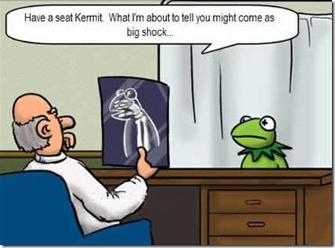
Have a seat, Kermit. Want I'm about to tell you might come as a big shock…

Slide 15
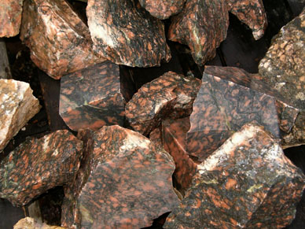
A Parable on Romans 8:28-30
51
One day a very wise and
skillful sculptor desired to make a
beautiful marble statute…

Slide 16
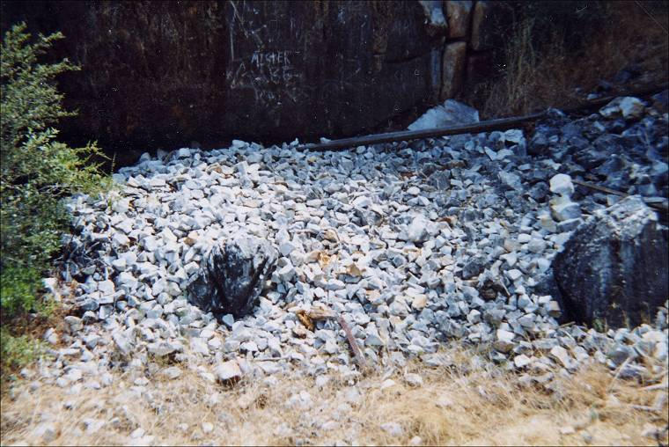
Foreknowledge
51
From among the many possibilities in the marble quarry he selected one rough stone which he would use for this purpose.

Slide 17
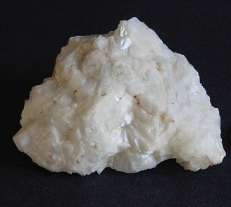
Predestination
51
He marked it and thereby destined it for the beautiful finished product which he had in mind. That mark preserved it from being discarded and destroyed.

Slide 18
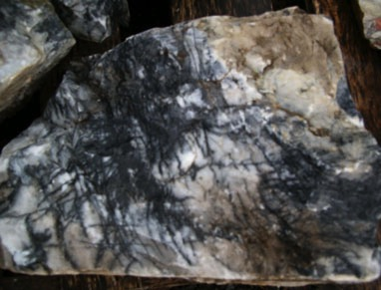
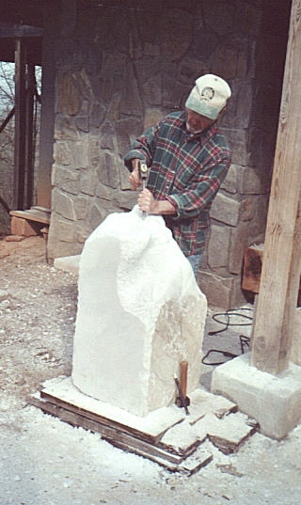
Calling and justification
51
Sometime later he sent his helper to fetch the stone and place it on his own work table.

Slide 19
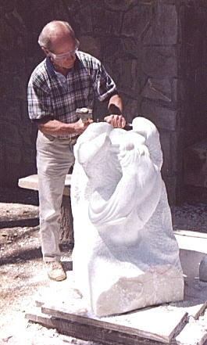
Progressive sanctification & eternal security
51
Then the sculptor began to chisel, rasp, and file on that block of rough stone shaping it into the likeness of the clay model that served as his pattern. In the process, however, he did nothing to ruin the stone and he saw to it that
no one else marred it either.

Slide 20
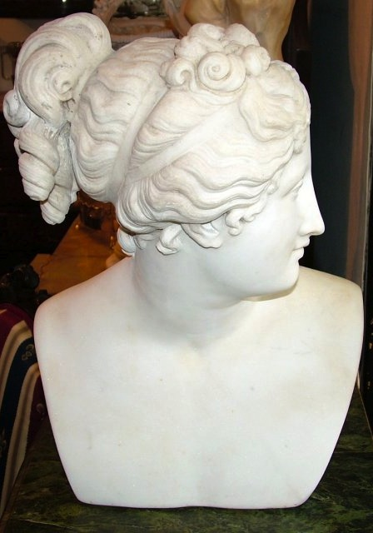
Rapture
51
Then one day his work was done. The statue was complete with all its features finely honed in full conformity with his clay model. The time had come to remove it from the clutter of the work bench and take it to the palace court where it would be unveiled for public display.

Slide 21
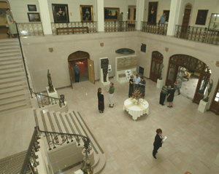
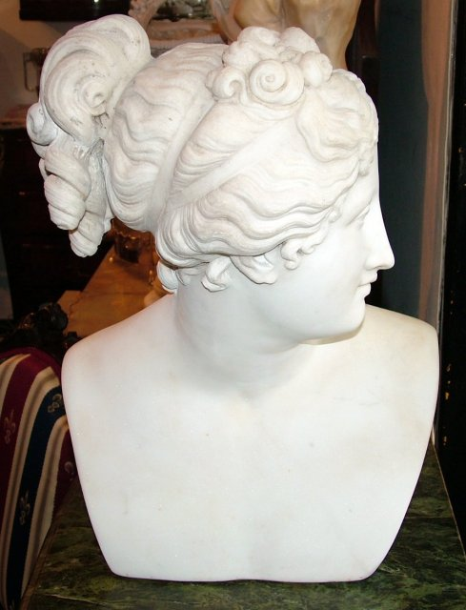
Glorification
51
And all those who passed by smiled their approval and gave accolades of praise to the wise and skillful sculptor.

Slide 22
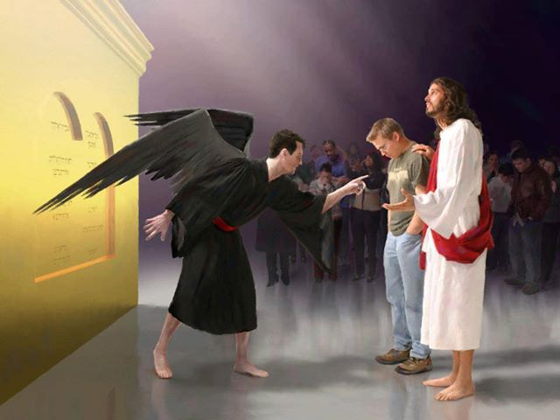
"Who then will condemn us? No one—for Christ Jesus died for us and was raised to life for us, and he is sitting in the place of honor at God's right hand, pleading for us."
Romans 8:34 (NLT)

Slide 23
Theological Words in Romans
55
Election
Romans 9:10-13
God's choice of an individual or group for a specific purpose or destiny
Justification
Romans 4:25; 5:18
God's act of declaring us "not guilty" for our sins, making us "right" with him
Propitiation
Romans 3:25
God removing punishment for sin by the perfect sacrifice of Jesus Christ so that God's righteous anger is satisfied
Redemption
Romans 3:24; 8:23
Jesus Christ has paid the price so we can go free. The price of sin is death; Jesus paid the price with his blood.
Sanctification
Romans 5:2; 15:16
Becoming more and more like Jesus Christ through the work of the Holy Spirit.
Glorification
Romans 8:18, 19, 30
The believer's final state of being in complete conformance to the character of Jesus Christ in a resurrected body that will last forever (1 John 3:2).

Slide 24

"For I am convinced that neither death, nor life, nor angels, nor principalities, nor things present, nor things to come, nor powers, nor height, nor depth, nor any other created thing, will be able to separate us from the love of God, which is in Christ Jesus our Lord."
Romans 8:38-39 (NAU)

Slide 25
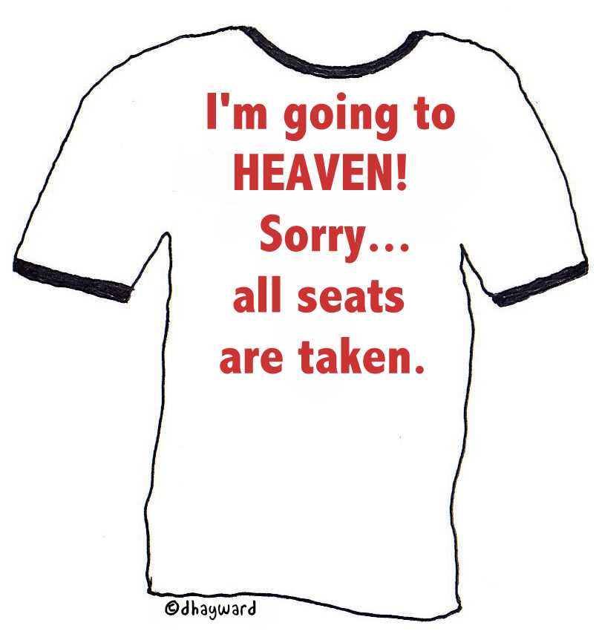
I'm going to HEAVEN!
Sorry… all seats are taken.

Slide 26

Is God's election fair?
Notes:
----- Meeting Notes (19/5/16 12:21) -----
Do you really want God to be fair?

Slide 27
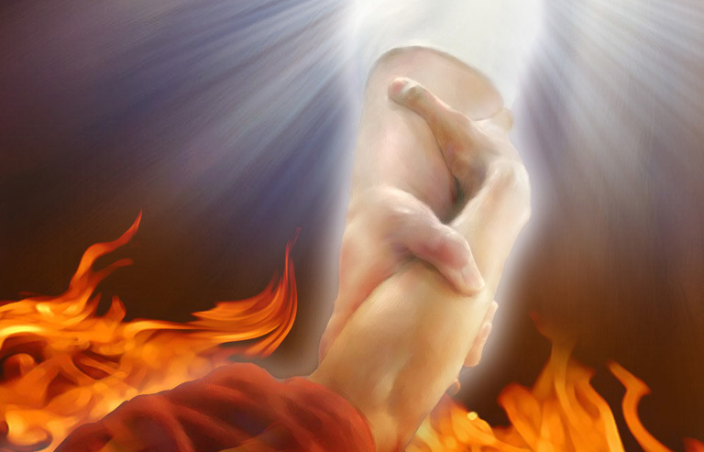
"Are we saying, then, that God was unfair? Of course not! ¹⁵For God said to Moses, 'I will show mercy to anyone I choose, and I will show compassion to anyone I choose.'
¹⁶So it is God who decides to show mercy. We can neither choose it nor work for it"
(Romans 9:14-16 NLT).

Slide 28
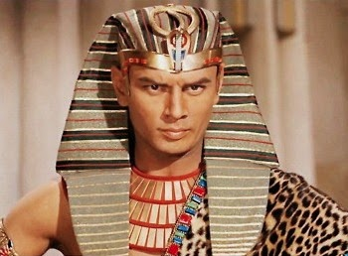
"For the Scriptures say that God told Pharaoh,
'I have appointed you for the very purpose of displaying my power in you and to spread my fame throughout the earth.'
¹⁸So you see, God chooses to show mercy to some, and he chooses to harden the hearts of others so they refuse to listen"
(Romans 9:17-18 NLT).

Slide 29
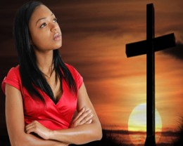
"Well then, you might say, 'Why does God blame people for not responding? Haven't they simply done what he makes them do?
²⁰No, don't say that. Who are you, a mere human being, to argue with God? Should the thing that was created say to the one who created it, 'Why have you made me like this?'"
(Romans 9:19-20 NLT).

Slide 30
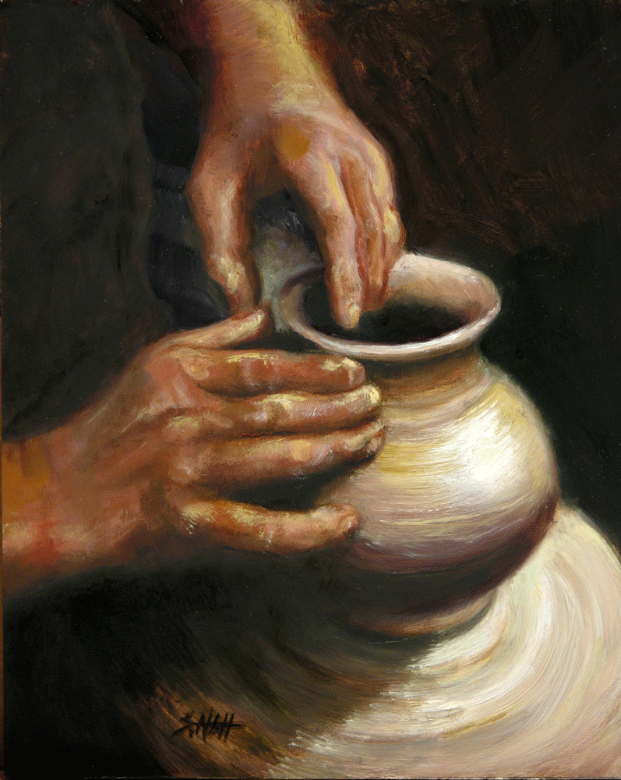
"When a potter makes jars out of clay, doesn't he have a right to use the same lump of clay to make one jar for decoration and another to throw garbage into?"
(Romans 9:21 NLT).

Slide 31

"In the same way, even though God has the right to show his anger and his power, he is very patient with those on whom his anger falls, who are destined for destruction. ²³He does this to make the riches of his glory shine even brighter on those to whom he shows mercy, who were prepared in advance for glory. ²⁴And we are among those whom he selected, both from the Jews and from the Gentiles” (Romans 9:22-24 NLT).

Slide 32

Righteousness in Romans
145
Theme | Needed | Provided | Imparted | Proved | Applied | Dissem-inated
Intro 1:1-17 | Condem-nation 1:18– 3:20 | Justifi-cation 3:21– 5:21 | Sanctifi-cation 6–8 | Election 9–11 | Trans-form-ation 12:1– 15:13 | Propa-gation 15:14– 16:27
Start | Sin | Salva-tion | Set Apart | Sove-reignty | Service | Send

Slide 33
Are all the following people really condemned without Christ?
MAKE HIM FAMOUS
around the corner and around the world
讓 全 世 界 都 知 道
～直到全地，直到地極～

Slide 34

Condemned?

Slide 35

Condemned?

Slide 36
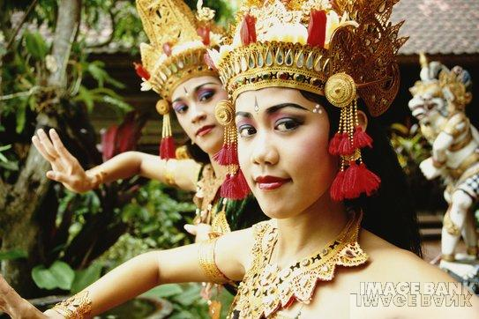
Condemned?

Slide 37
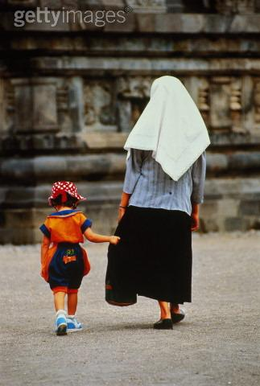
Condemned?

Slide 38
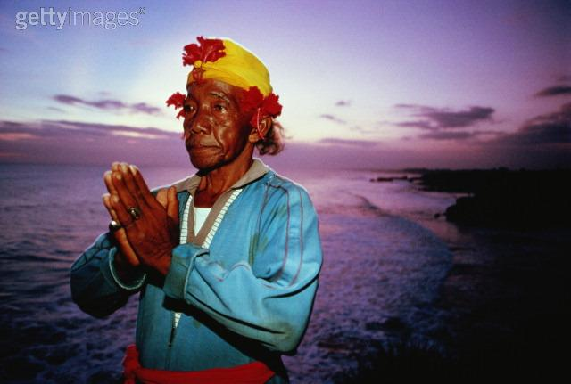
Condemned?

Slide 39

Condemned?

Slide 40

Condemned?

Slide 41

Condemned?

Slide 42

Condemned?

Slide 43

Condemned?

Slide 44

Condemned?

Slide 45

Condemned?

Slide 46

Condemned?

Slide 47

Condemned?

Slide 48

Condemned?

Slide 49
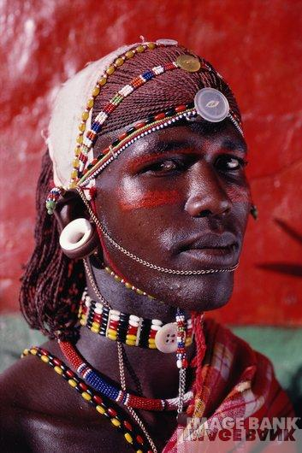
Condemned?

Slide 50
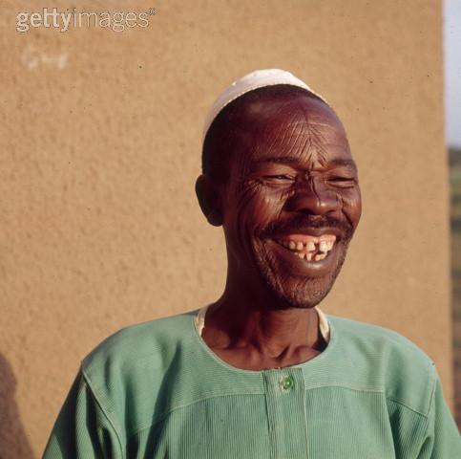
Condemned?

Slide 51

Condemned?

Slide 52
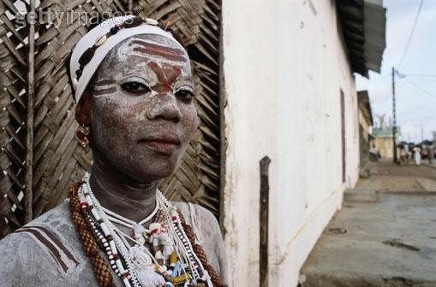
Condemned?

Slide 53

Condemned?

Slide 54

Condemned?

Slide 55

Condemned?

Slide 56
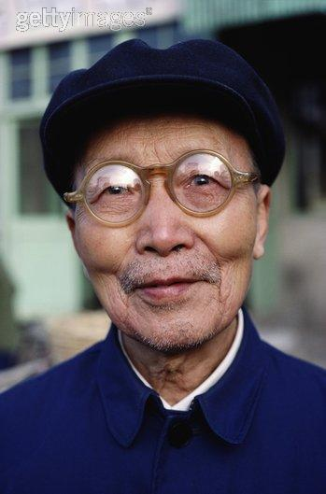
Condemned?

Slide 57

Condemned?

Slide 58

Condemned?

Slide 59

Condemned?

Slide 60

Condemned?

Slide 61
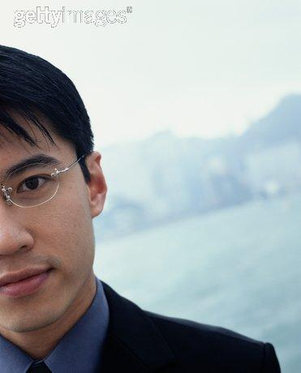
Condemned?

Slide 62

Condemned?

Slide 63
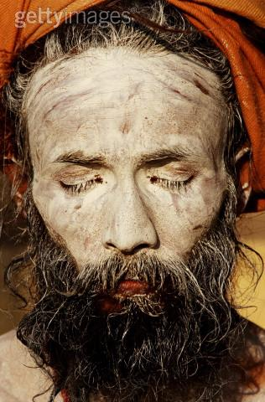
Condemned?

Slide 64
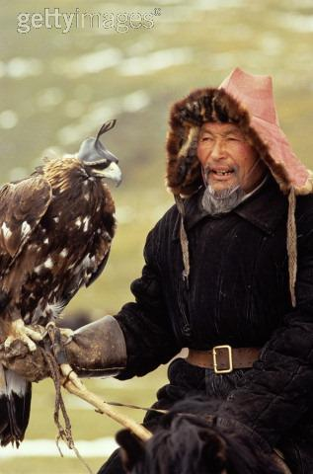
Condemned?

Slide 65
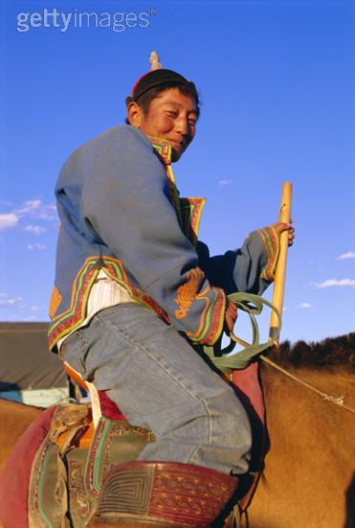
Condemned?

Slide 66

Condemned?

Slide 67

Condemned?

Slide 68

Condemned?

Slide 69

Condemned?

Slide 70

Condemned?

Slide 71

Condemned?

Slide 72

Condemned?

Slide 73

Condemned?

Slide 74
Are all the preceding people really condemned without Christ?
MAKE HIM FAMOUS
around the corner and around the world
讓 全 世 界 都 知 道
～直到全地，直到地極～

Slide 75
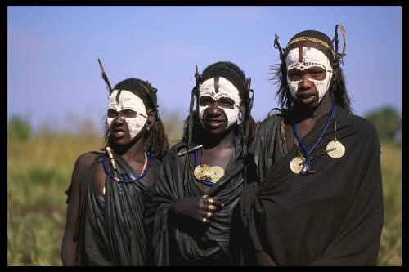

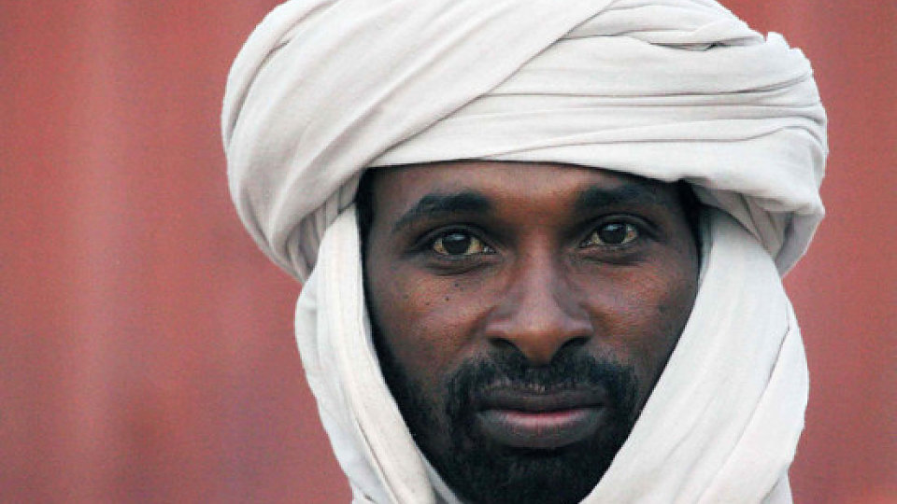
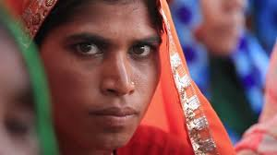
What About the Unreached?
52

Slide 76
Hell: What if it's Real?
Notes:
tomstyle.com/ archive/hell.jpg

Slide 77
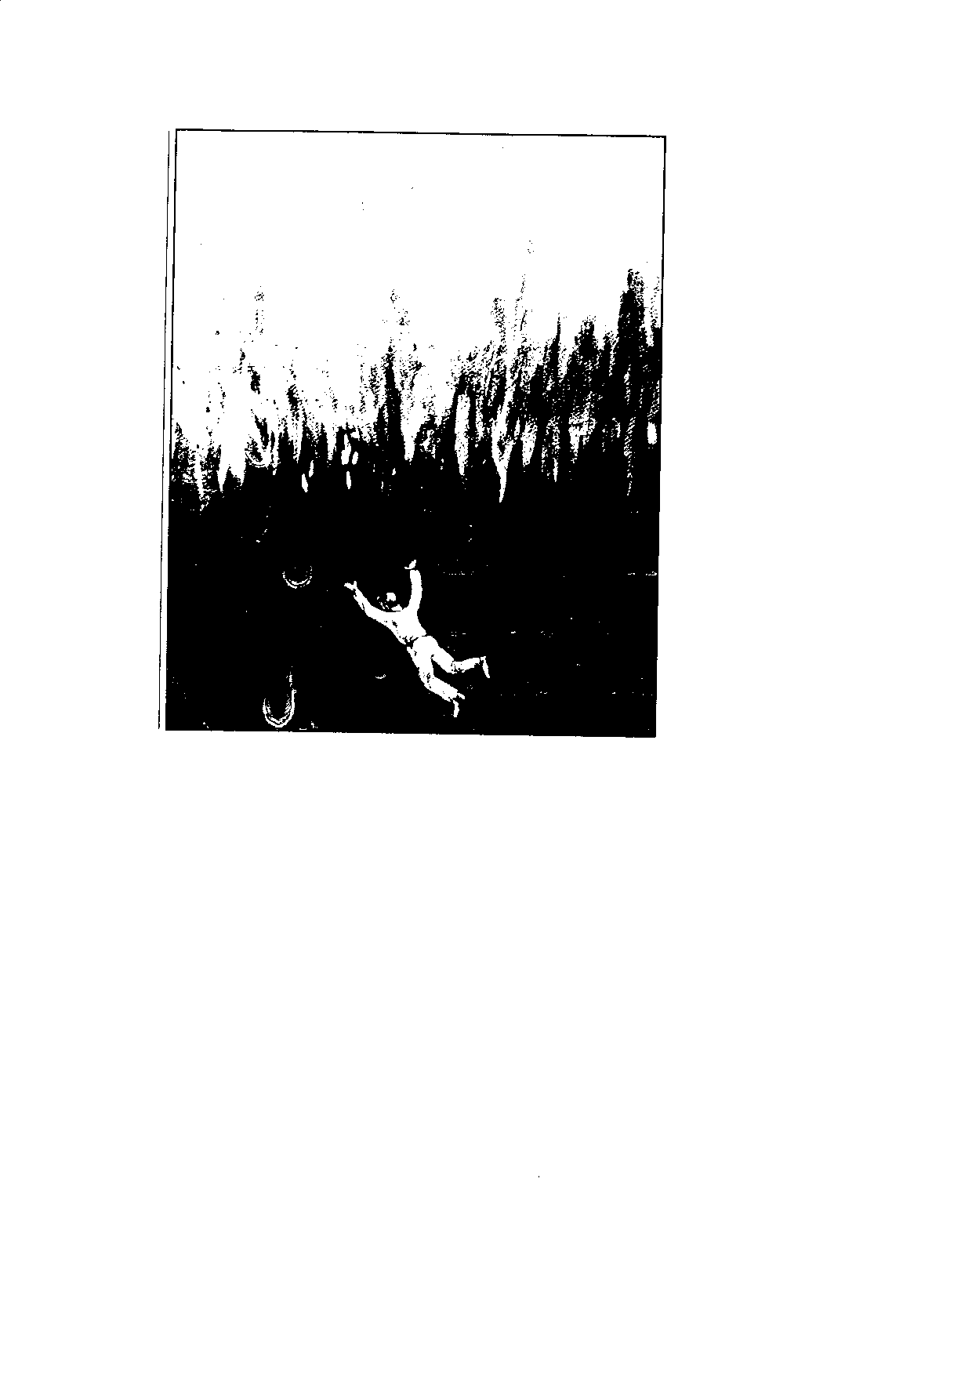
"If anyone's name was not found written in the book of life, that person was thrown into the lake of fire"
(Rev. 20:15 NET Bible)

Slide 78
Attacks on Hell
52
Universalism
Annihilationism
Purgatory

Slide 79
Universalism
52
pt. a
What is it?
Arguments cited
Rebuttals

Slide 80


Recent Universalism
Notes:
http://www.cbn.com/cbnnews/us/2011/april/love-wins-pastor-caught-off-guard-by-controversy/
'Love Wins' Pastor Caught Off Guard by Controversy
By Crystal Woodall CBN News Internet Producer
Sunday, April 10, 2011
Print 35 Comment(s)
Ad Feedback
Evangelical megachurch pastor Rob Bell says he was caught off guard by the condemnation his new book has received from leaders in the Christian community.
Standing before an audience of about 1,600 at Nashville's Belmont University, Bell said the last several weeks had been the "most painful" of his life.
"It has taken me to a place of profound brokenness," said Bell, who pastors the 10,000-member Mars Hill Bible Church in Grand Rapids, Mich.
Love Wins: Heaven, Hell, and the Fate of Every Person Who Ever Lived, released March 29, challenges the traditional Christian belief that few will enter Heaven.
"Will only a few select people make it into Heaven and will billions of people burn forever in Hell?" Bell asks in a promotional video of his book, recently released by publisher HarperOne. "And if that's the case, how do you become one of the few?" Watch the video here.
Bell insists it was never his intent to stir controversy, but to bring focus back to a message he suggests has got lost in dogma -- the love of God.
"I kept meeting religious people who were incredibly dogmatic about heaven and hell when you die but didn't seem to care about the fact that 8 million people will go to bed hungry tonight," Bell explained.
Bell denies charges that his book promotes a universalist theology - the belief that everyone, regardless of belief, will be saved by God.
"No, if by universalist we mean there's a giant cosmic arm that swoops everybody in at some point whether you want to be there or not," he told The Christian Post.
"That violates the laws of love and love is about freedom," he explained. "It's about choice; it's about do you want to be there? Because that's what would make it heaven."
According to the Associated Press, Bell says hell is something freely chosen that already exists on earth.
"Apparently this is a pastor who has written a book who has grown uncomfortable contending for the faith," CBN chaplain and Regent University theology professor Joel Palser said. "He is no longer able to defend what the Bible says and has endeavored to make that more palatable to modern culture."
"It may be trendy and it might sell a lot of books, but in fact Jesus speaks very clearly about heaven and hell," Palser added.

Slide 81

Of his 10,000-member Grand Rapids Mars Hill Bible Church, 3000 left after the book, then Bell himself left for California to run a "faith-inflected talk show"
Notes:
http://www.cbn.com/cbnnews/us/2011/april/love-wins-pastor-caught-off-guard-by-controversy/
'Love Wins' Pastor Caught Off Guard by Controversy
By Crystal Woodall CBN News Internet Producer
Sunday, April 10, 2011
Print 35 Comment(s)
Ad Feedback
Evangelical megachurch pastor Rob Bell says he was caught off guard by the condemnation his new book has received from leaders in the Christian community.
Standing before an audience of about 1,600 at Nashville's Belmont University, Bell said the last several weeks had been the "most painful" of his life.
"It has taken me to a place of profound brokenness," said Bell, who pastors the 10,000-member Mars Hill Bible Church in Grand Rapids, Mich.
Love Wins: Heaven, Hell, and the Fate of Every Person Who Ever Lived, released March 29, challenges the traditional Christian belief that few will enter Heaven.
"Will only a few select people make it into Heaven and will billions of people burn forever in Hell?" Bell asks in a promotional video of his book, recently released by publisher HarperOne. "And if that's the case, how do you become one of the few?" Watch the video here.
Bell insists it was never his intent to stir controversy, but to bring focus back to a message he suggests has got lost in dogma -- the love of God.
"I kept meeting religious people who were incredibly dogmatic about heaven and hell when you die but didn't seem to care about the fact that 8 million people will go to bed hungry tonight," Bell explained.
Bell denies charges that his book promotes a universalist theology - the belief that everyone, regardless of belief, will be saved by God.
"No, if by universalist we mean there's a giant cosmic arm that swoops everybody in at some point whether you want to be there or not," he told The Christian Post.
"That violates the laws of love and love is about freedom," he explained. "It's about choice; it's about do you want to be there? Because that's what would make it heaven."
According to the Associated Press, Bell says hell is something freely chosen that already exists on earth.
"Apparently this is a pastor who has written a book who has grown uncomfortable contending for the faith," CBN chaplain and Regent University theology professor Joel Palser said. "He is no longer able to defend what the Bible says and has endeavored to make that more palatable to modern culture."
"It may be trendy and it might sell a lot of books, but in fact Jesus speaks very clearly about heaven and hell," Palser added.

Slide 82
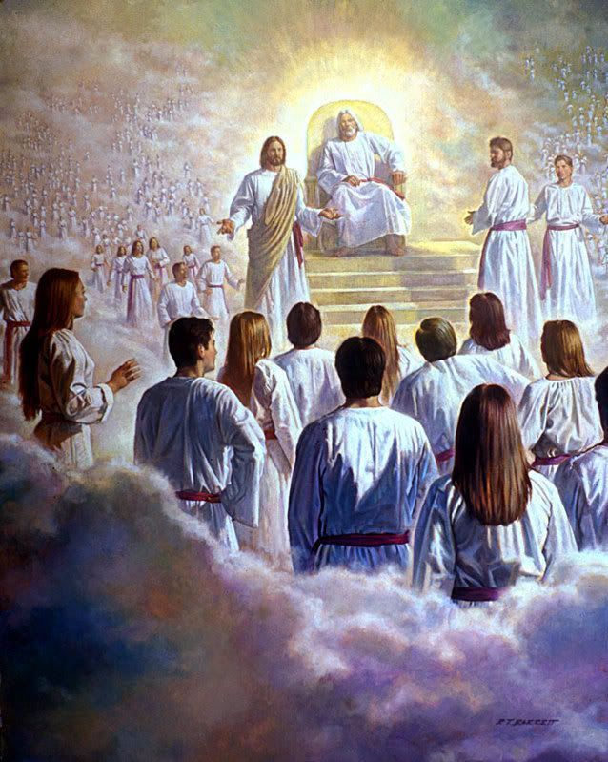
"Then I saw a great white throne…"
(20:11)

Slide 83
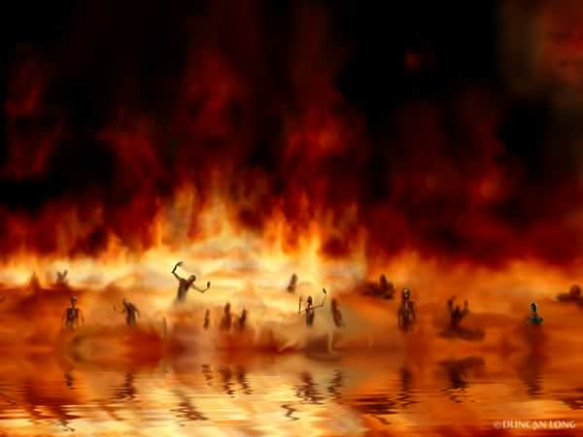
The Lake of Fire (20:14-15)

Slide 84
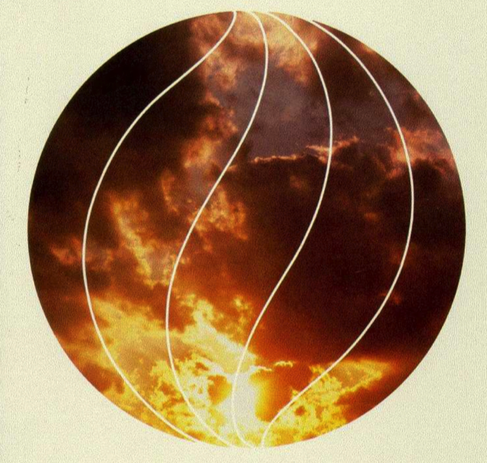
Annihilationism
52
What is it?
Arguments cited
Rebuttals

Slide 85

Annihilationist Groups
52
Seventh-Day Adventists
Jehovah's Witnesses
Some "Evangelicals"?

Slide 86

Annihilationist Arguments
52
Rebuttals
God is too nice to send people to eternal hell
God is absolutely just and holy
"Destruction" implies annihilation
"Destruction" refers to physical death

Slide 87
Church of England Report,
January 1996
"Hell as ultimate non-being is the way in which we've put it. The horrible demons are the imaginations of inventors and medievalists."
Bishop John Taylor
One of the authors of the report

Slide 88

Purgatory
52
pt. b
What is it?

Slide 89
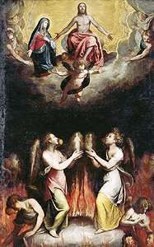
Arguments Cited for Purgatory
52
pt. b
"Not good enough for heaven but not bad enough for hell"
2 Maccabees

Slide 90
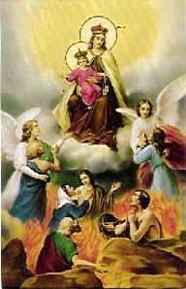
Rebuttals to Purgatory
52
pt. b
Salvation by works
Apocrypha
No second chance

Slide 91

The "It's sincerity that counts most" argument
52
pt. c

Slide 92
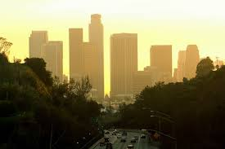
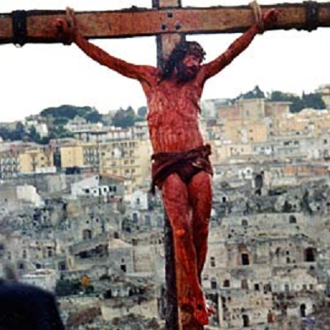
Another view…
52
pt. d
Responding in faith to the light received
God saves them based on Christ's death
=

Slide 93
The only proper response to the state of the unevangelized is that they indeed are lost without Christ. This is supported in several ways…
52
pt. e

Slide 94
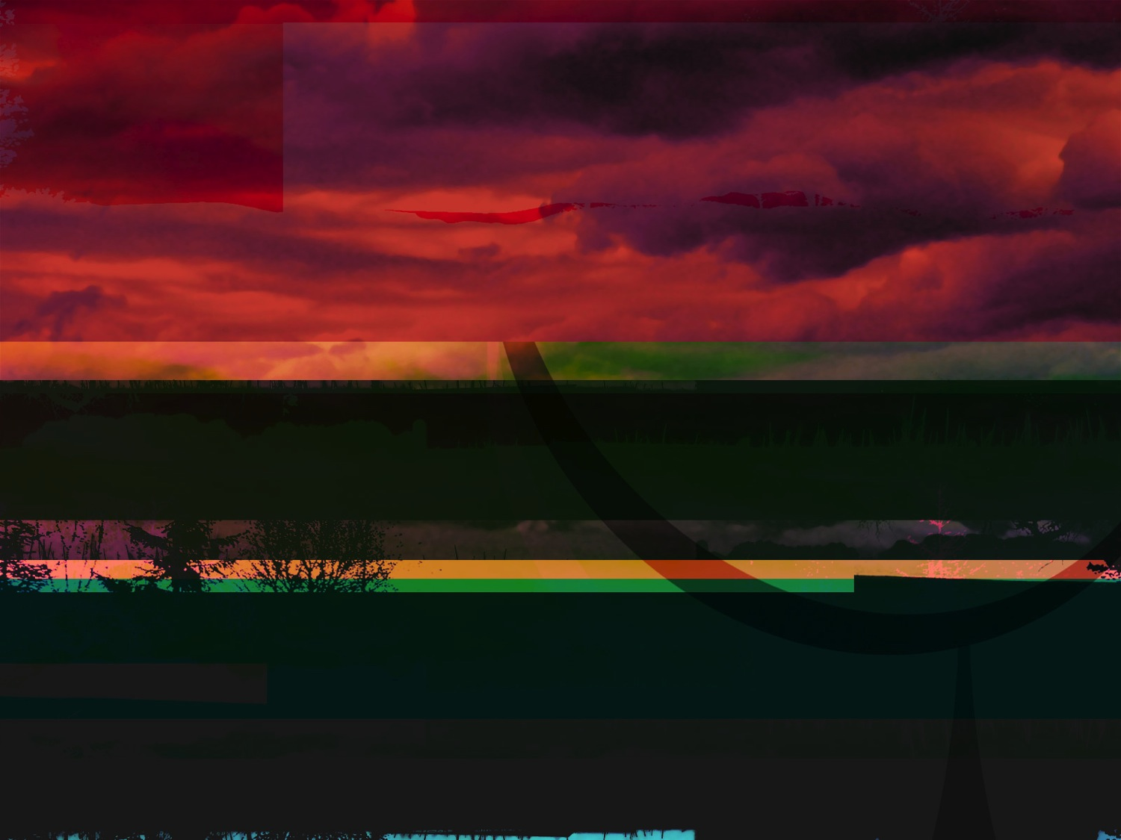
God's Wrath (Romans 1:18-20)
52
pt. a
The Reality (18a)
The Reason (18b-20a)
The Result (20b)

Slide 95


Why You Are Without Excuse (Romans 1:20)
52
pt. a
WHY YOU ARE
WITHOUT
EXCUSE
ROMANS 1:20
Notes:
Please translate the text at the left and then drag everything over this slide so no English shows. Make sure the fonts remain.

Slide 96

Romans 1:20
52
pt. a
Person who is Limitless
Person who is Supernatural
For since the creation of the world God's invisible qualities-- his eternal power and divine nature— have been clearly seen, being understood from what has been made, so that men are without excuse (NIV).
For since the creation of the world God's invisible qualities-- his eternal power and divine nature-- have been clearly seen, being understood from what has been made, so that men are without excuse (NIV).

Slide 97
Romans 1:20
52
pt. a
Since the start of creation…
people have seen God
= literal 24-hour days
For since the creation of the world God's invisible qualities-- his eternal power and divine nature— have been clearly seen, being understood from what has been made, so that men are without excuse (NIV).
For since the creation of the world God's invisible qualities-- his eternal power and divine nature-- have been clearly seen, being understood from what has been made, so that men are without excuse (NIV).

Slide 98
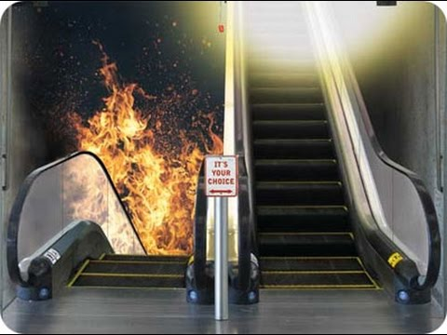
IT'S YOUR CHOICE

Slide 99

Why God is Angry at Gentiles
(Rom. 1:21-32)
52
e.1)b]
Ignore God (21-23)
God gave them over
Impurity (24)
Idolatry (25)
God gave them over
Homosexuality (26-27)

Slide 100
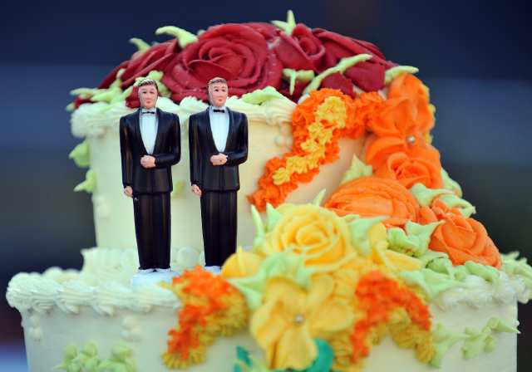
What About Homosexuality?

Slide 101

What About Same Sex "Marriage"?
See Family Research Council (frcblog) on YouTube
Notes:
The link is http://www.youtube.com/watch?v=nPgZ2Mq1Ugw

Slide 102
Why God is Angry at Gentiles
(Rom. 1:21-32)
52
e.1)b]
Ignore God (21-23)
God gave them over
Impurity (24)
Idolatry (25)
God gave them over
Homosexuality (26-27)
God gave them over
Depravity (28-32)

Slide 103
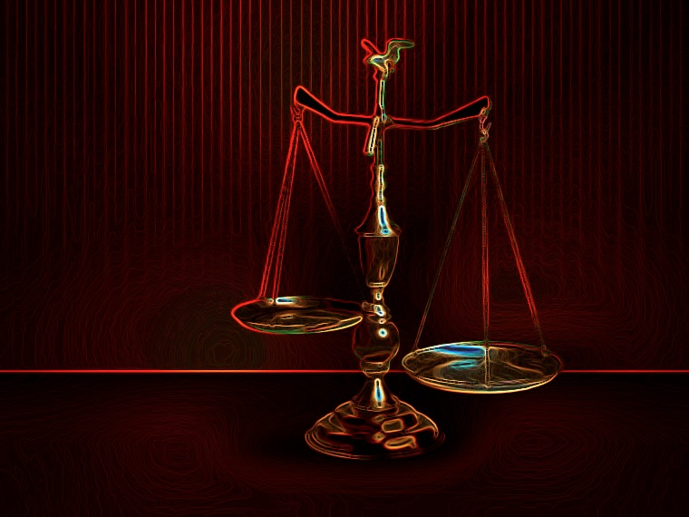
All Are Under Sin
^{10b} "No one is righteous—
not even one.
¹¹ No one is truly wise;
no one is seeking God.
¹² All have turned away;
all have become useless.
No one does good,
not a single one (Pss 14:1-3; 53:1-3–Greek version).
¹³ "Their talk is foul, like… stench from an open grave.
Their tongues are filled with lies."
"Snake venom drips from their lips" (Ps 5:9 Gr.; 140:3).
¹⁴ "Their mouths are full of cursing and bitterness" (Ps 10:7 Gr. version).
¹⁵ "They rush to commit murder.
¹⁶ Destruction and misery always follow them.
¹⁷ They don't know where to find peace" (Isa 59:7-8).
¹⁸ "They have no fear of God at all."
  (Rom 3:10b-18 NLT)
52
e.1)c]

Slide 104
The Law Won't Save
52
e.1)c]
¹⁹ Obviously, the law applies to those to whom it was given, for its purpose is to keep people from having excuses, and to show that the entire world is guilty before God. ²⁰ For no one can ever be made right with God by doing what the law commands. The law simply shows us how sinful we are.
  (Rom 3:19-20 NLT)

Slide 105
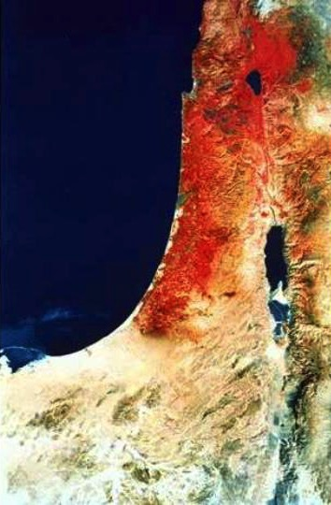
Acts 1:8 NAU
"remotest part"
53
e.2)
"But you shall receive power when the Holy Spirit has come upon you; and you shall be My witnesses both in Jerusalem, and in all Judea and Samaria, and even to the remotest part of the earth."
Samaria
Jerusalem
Judea

Slide 106

Paul's Calling: Gentiles in the Body
53
e.3)

Slide 107

Paul's Ministry Westwards
53
e.3)
Illyricum
Rome
Jerusalem

Slide 108
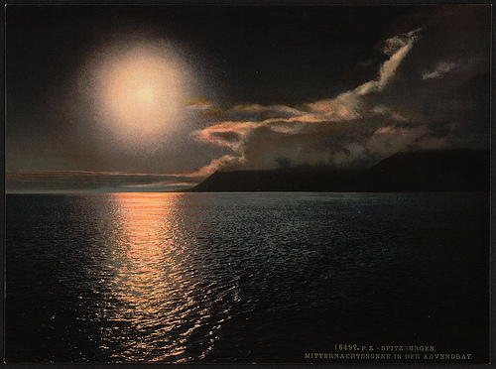
Romans 15:20-22
53
e.3)
²⁰ My ambition has always been to preach the Good News where the name of Christ has never been heard, rather than where a church has already been started by someone else.
²¹ I have been following the plan spoken of in the Scriptures, where it says,
"Those who have never been told about him will see, and those who have never heard of him will understand."
²² In fact, my visit to you has been delayed so long because I have been preaching in these places.
––Romans 15:20-22

Slide 109

The Logical Argument
53
e.4)
If the unreached are not headed for hell, then the worst thing a Christian could do is to tell them about Christ! Why? Because if they hear the message, there's a possibility of rejecting it and going to hell; however, if they don't hear the message in the first place, hell isn't even a possibility. Therefore, the best decision is to call back all our missionaries.

Slide 110
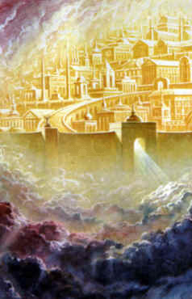

What's the Difference?
53
pt. 2
Grace
Mercy
…is God
giving us
what we
do not
deserve
…is God
not giving us
what we
do
deserve

Slide 111

What about babies who die?
53
pt. 2
I believe that they go to heaven based on two texts:
David showed confidence to see his infant son who died (2 Sam. 12:23).
Jesus noted that the kingdom of God belonged to little children (Mark 10:14-15).

Slide 112

How can I communicate hell to non-Christians?
53
pt. 3
A few suggestions:
a. Don't be afraid to talk about hell. Jesus wasn't! Christ talked about hell even more than He did about heaven.
b. Talk about sin in your evangelistic presentations. Talk about how God is holy and just and thus must judge sin.
c. Remind unbelievers that hell was "prepared for the devil and his angels" (Matt. 25:41). Man through his disobedience has entered into this arrangement.

Slide 113
How can I communicate hell to non-Christians?
53
pt. 3
A few suggestions:
d. Avoid speaking of hell and sin as "spiritual separation from God." Unbelievers are used to being separated from God and because of their sin many have convinced themselves that separation is good—so this hardly seems like a punishment!
e. Teach about hell in balance with even more fundamental doctrines

Slide 114
Salvation by Works?
Works Verses
Rom. 2:6 God "will give to each person according to what he has done."
Rom. 2:7 To those who by persistence in doing good seek glory, honor and immortality, he will give eternal life.
Rom. 2:8 But for those who are self-seeking and who reject the truth and follow evil, there will be wrath and anger.
Rom. 2:13 For it is not those who hear the law who are righteous in God's sight, but it is those who obey the law who will be declared righteous.
Explanation
These verses seem to teach salvation by works while others teach salvation by faith (e.g., Rom. 3:20). Paul appears to teach salvation by works elsewhere (cf. 1 Cor. 6:9-11; 2 Cor. 5:10; Gal. 5:21) but he did not see these as contradicting.
It is better to see Romans 2:7, 13 as hypothetical. Paul simply says that eternal life would be possible if one could keep the law entirely, but since no one can do this then all alike are under sin.
This fits his argument that all persons are under judgment in Romans 1–3 and it also harmonizes well with 3:19-20.
155g
54

Slide 115

Can you really say, "God loves you" to anyone?

Slide 116
Black

Slide 117


Salvation link at BibleStudyDownloads.org
Get this presentation and script for free!

